Slide 1
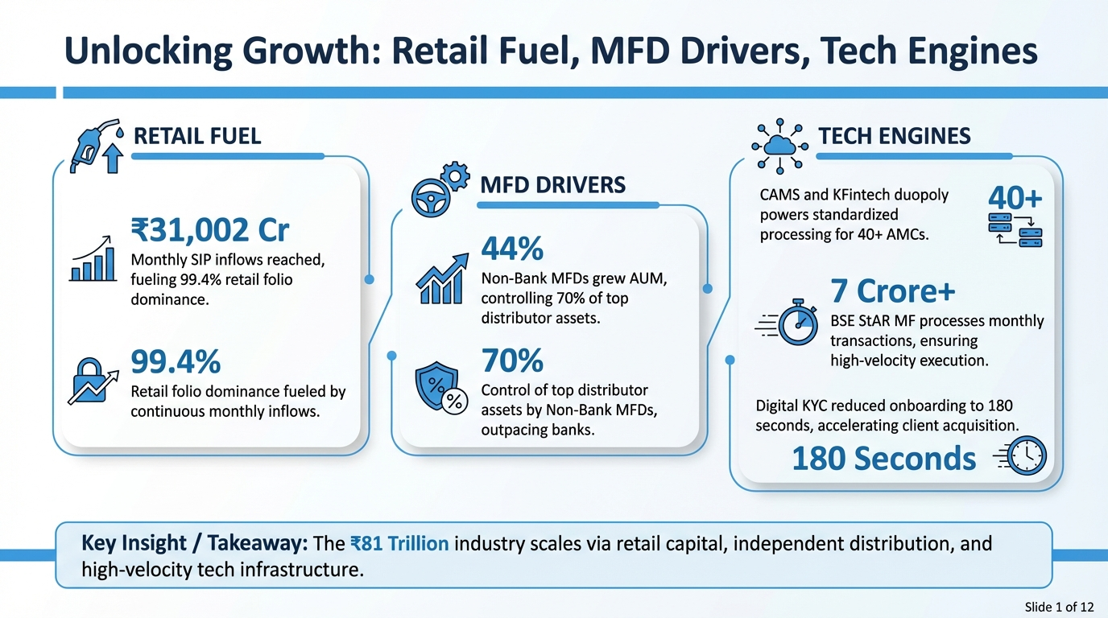

Slide 2
Converging SIPs, Tech, and MFDs Drive Self-Sustaining Growth
▸ Industry AUM reached ₹81.01 Trillion in Jan 2026, driven by retail velocity.
▸ Monthly SIP inflows hit record ₹31,002 crore, acting as stable, non-discretionary fuel.
▸ Non-Bank MFDs grew 44% YoY, capturing 70% market share via tech-led scalability.
▸ Retail and HNI investors now control 99.5% of folios, ensuring granular capital stability.
Growth Component | Key Metric | Current Value | Trend / Insight
Output (Scale) | Industry AUM | ₹81.01 Trillion | Validates 6x decade growth projection
Fuel (Retail) | Monthly SIP Inflow | ₹31,002 Crore | Historic high; 10.29 Cr active accounts
Driver (Distribution) | Non-Bank MFD Growth | 44% YoY | Outperforming Banks (30%)
Stability (Behavior) | Retail/HNI Folio Share | 99.5% | High granularity; 0.5% institutional share
Sources: AMFI, ICICI Direct, AssetPlus Academy, India Infoline (Data as of Jan/Feb 2026)
★ KEY INSIGHT: The convergence of SIPs, Non-Bank MFDs, and Tech has created a self-sustaining growth loop.
Client Databases: The Invisible Engine Behind Scal...
Slide 2 of 12

Slide 3
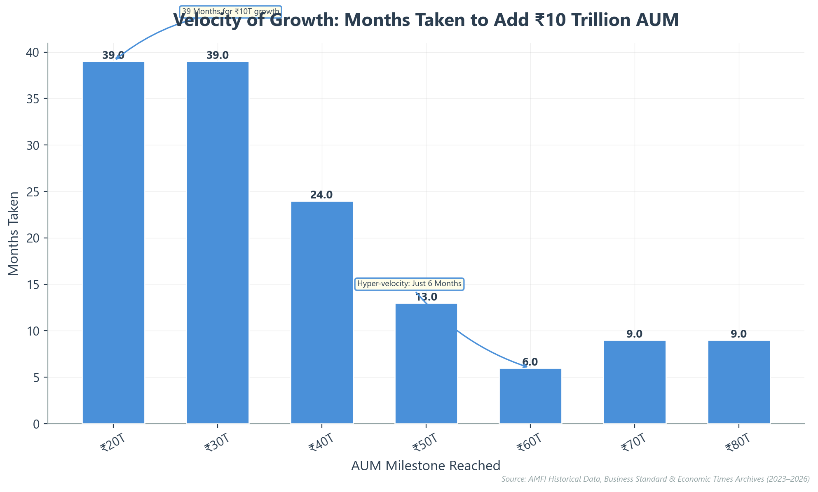
Exponential AUM Accumulation Outpaces Manual Capabilities
▸ Industry AUM surged 6x in the last decade, reaching ₹81.01 trillion in January 2026.
▸ Velocity has accelerated dramatically: adding ₹10 trillion now takes months, not years.
▸ The sprint from ₹50T to ₹60T took just 6 months, compared to 39 months for early milestones.
▸ Record SIP inflows of ₹31,002 crore/month fuel this non-linear growth trajectory.
▸ Legacy manual operations cannot scale to support this compressed transaction volume.
★ KEY INSIGHT: The velocity of asset accumulation has compressed from 39 months per ₹10T to under 9 months.
Client Databases: The Invisible Engine Behind Scal...
Slide 3 of 12

Slide 4
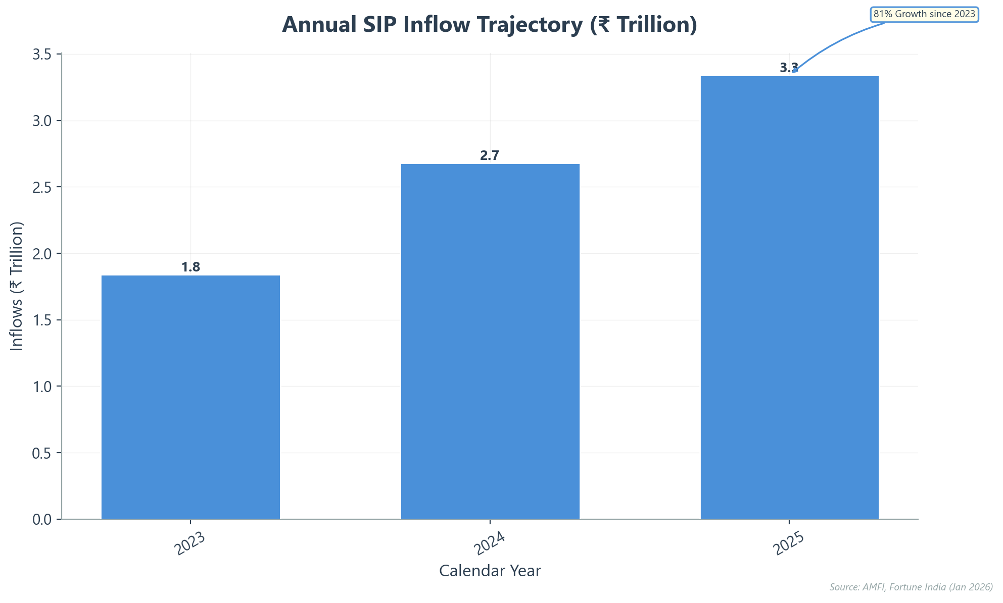
SIPs Anchor Market Stability Through Behavioral Lock-in
▸ Monthly inflows sustained ₹31,000 Cr+ levels, totaling ₹3.34 Lakh Cr in 2025.
▸ Active accounts reached 10.29 Crore, showing resilience despite regulatory cleanup.
▸ SIPs now drive 37% of gross equity inflows, acting as permanent capital.
▸ Total SIP AUM stands at ₹16.36 Trillion, representing ~20% of industry assets.
▸ Investor behavior shifted from "timing the market" to disciplined "time in the market."
★ KEY INSIGHT: SIPs have evolved from a simple product to a national behavioral lock-in.
Client Databases: The Invisible Engine Behind Scal...
Slide 4 of 12

Slide 5
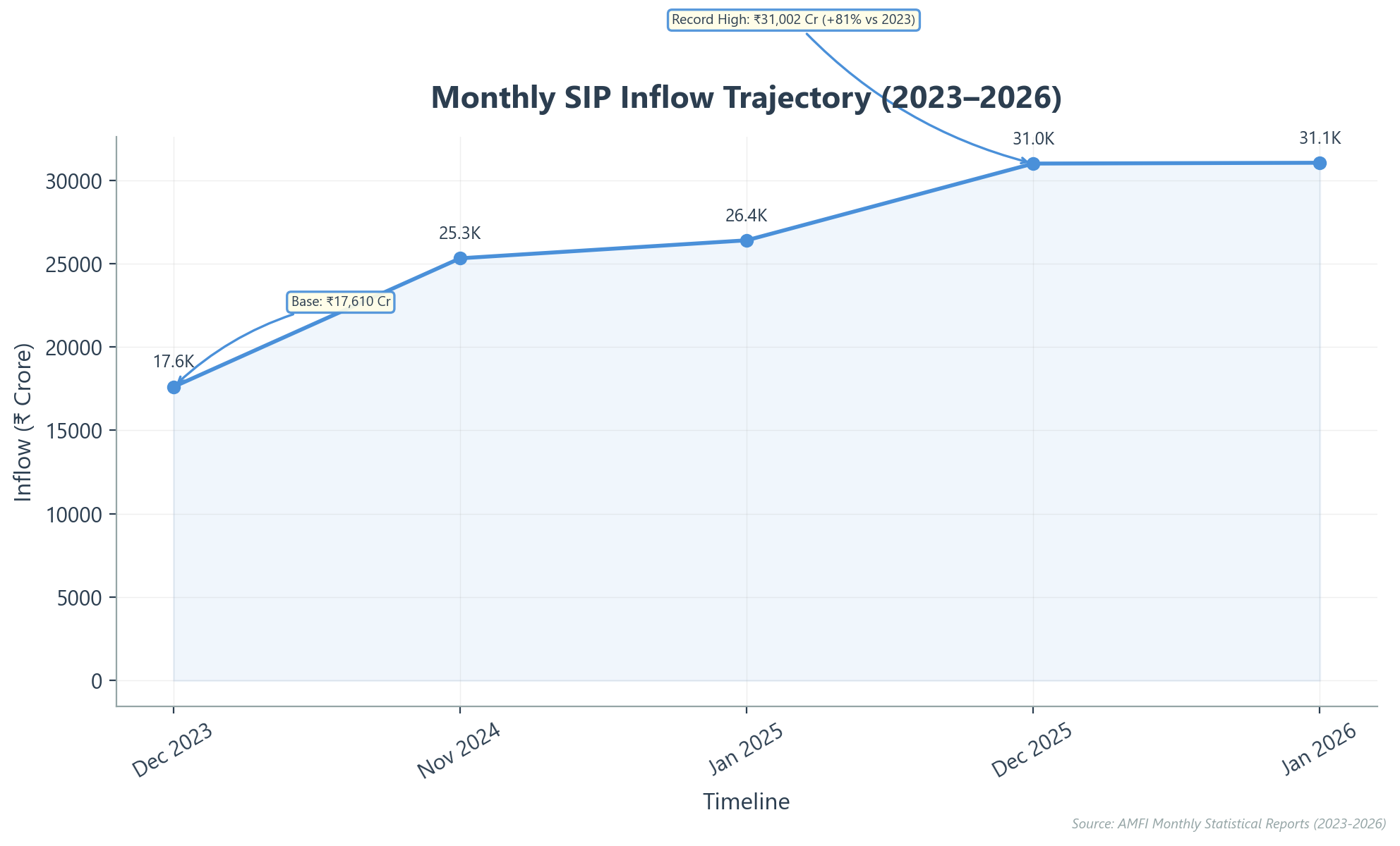
Monthly SIP Inflows Breach ₹31,000 Cr, Validating Retail Shift
▸ Monthly inflows hit record ₹31,002 Cr in Dec 2025, rising 81% from 2023.
▸ Momentum sustained in Jan 2026 (>₹31,000 Cr) despite market volatility.
▸ Active SIP accounts crossed the 10-crore milestone in Jan 2026.
▸ SIP AUM reached ₹16.36 Lakh Cr, comprising ~20% of total industry assets.
▸ Annual SIP collections surged 25% YoY to a record ₹3.34 Lakh Cr in 2025.
★ KEY INSIGHT: Monthly SIP inflows have structurally reset, crossing the ₹31,000 crore threshold and demonstrating resilience against market fluctuations.
Client Databases: The Invisible Engine Behind Scal...
Slide 5 of 12

Slide 6
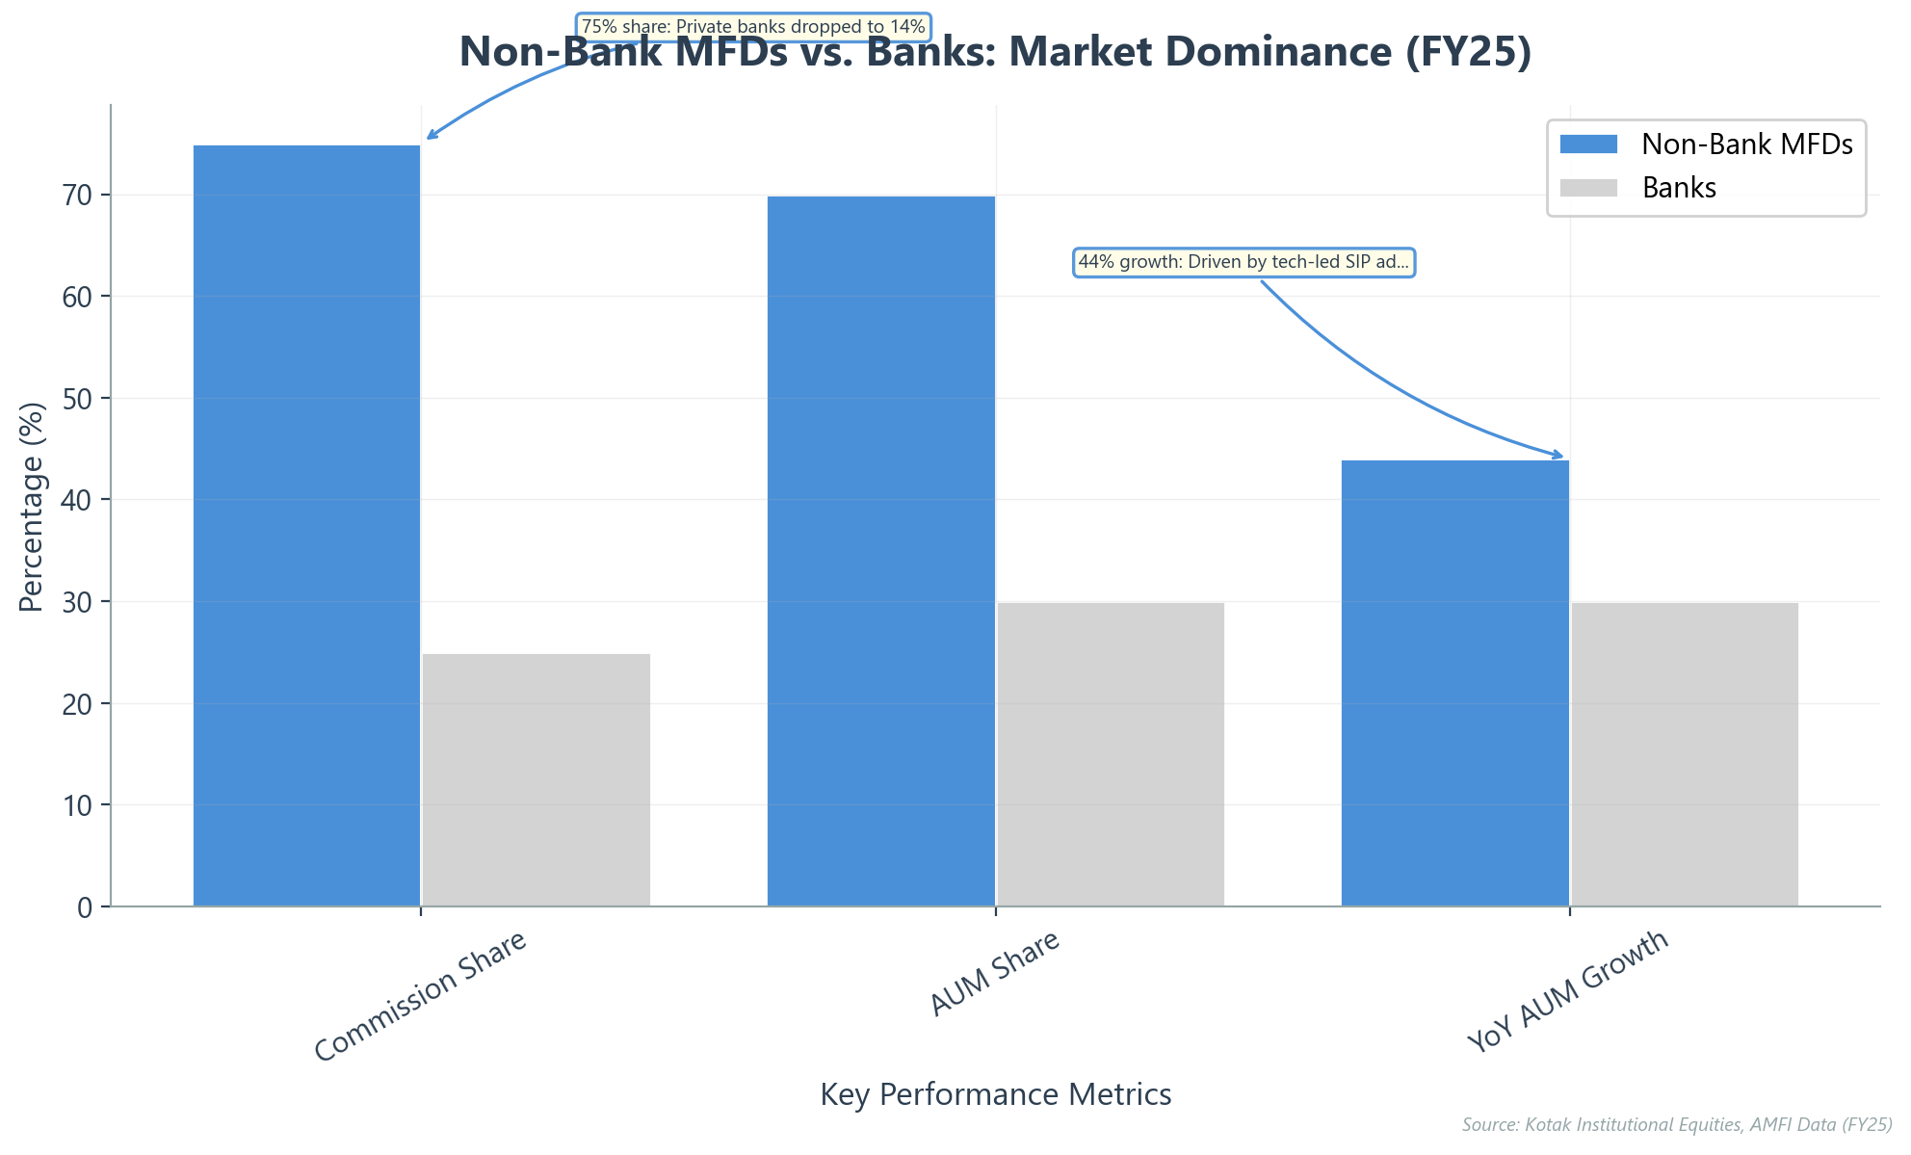
Non-Bank MFDs Dominate Growth via Tech-First Agility
▸ Non-banks capture 75% of industry commissions, shrinking banks' share to just 25%.
▸ Independent distributors grew AUM by 44% YoY in FY25, significantly outpacing banks' 30%.
▸ Tech platforms like Prudent drive 40% CAGR by automating compliance and operations.
▸ Non-banks control 70% of distributor assets, leveraging digital tools for deeper retail penetration.
★ KEY INSIGHT: Tech-first independent distributors now control 75% of commissions and 70% of assets, outpacing traditional banks.
Client Databases: The Invisible Engine Behind Scal...
Slide 6 of 12

Slide 7
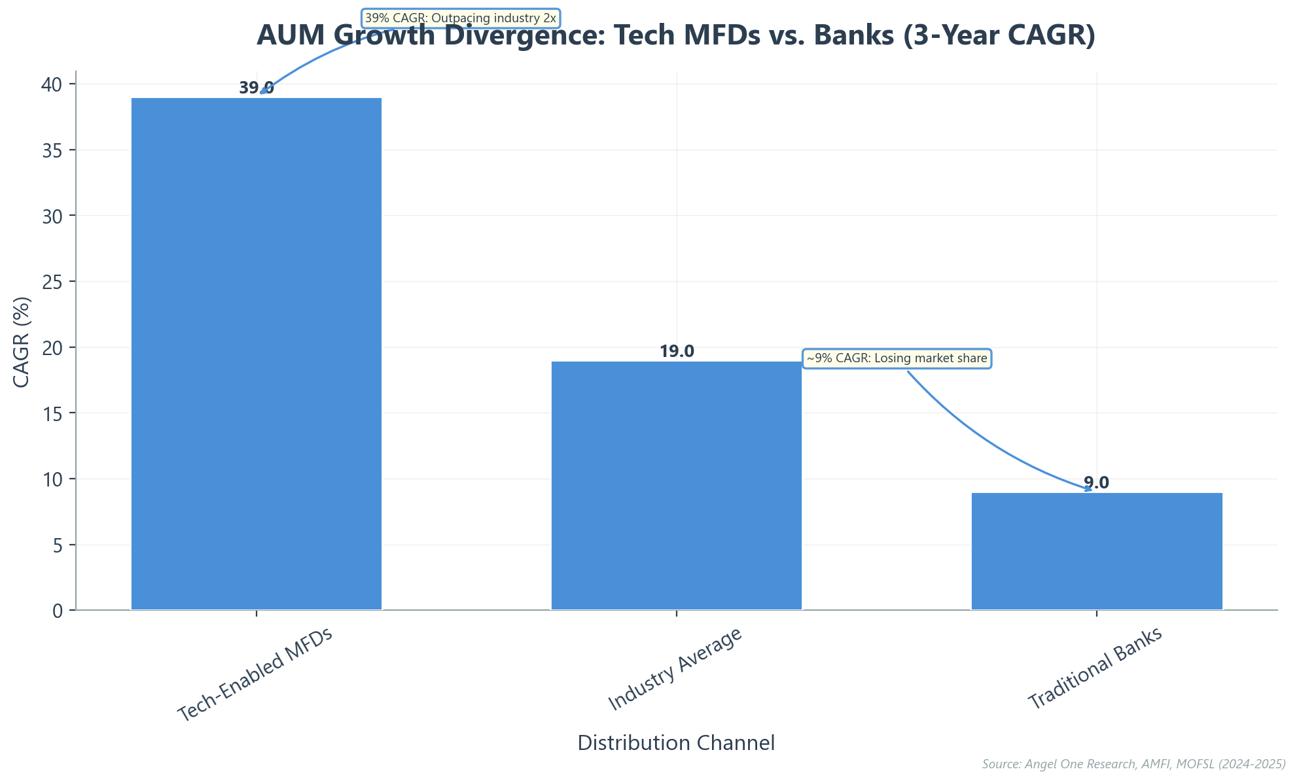
Tech-Enabled MFDs Outpace Traditional Banks 4x
Client Databases: The Invisible Engine Behind Scal...
Slide 7 of 12

Slide 8
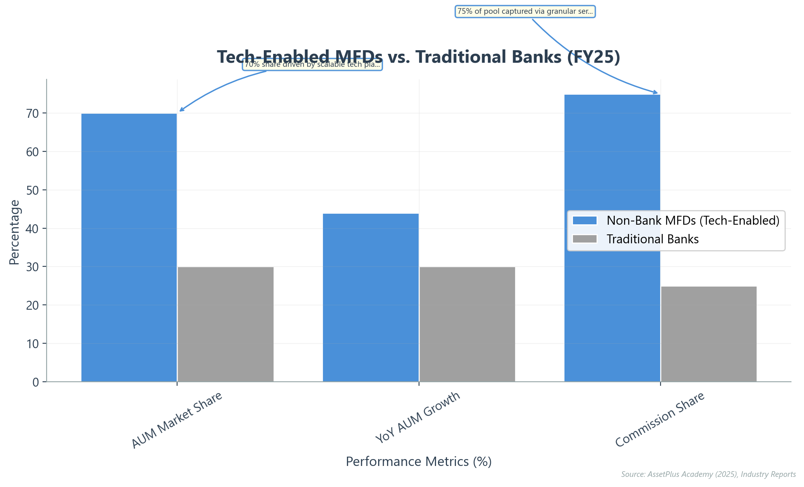
Scaling Operations: Databases Convert Potential Into Assets
▸ **Core Infrastructure:** CRM and RTA platforms unify over 10 crore investor folios.
▸ **Speed:** Digital onboarding takes 180 seconds, replacing days of manual paperwork.
▸ **Dominance:** Tech-enabled MFDs captured 70% market share via scalable automation.
▸ **Retention:** Automated tracking maintains ~94% active contributing SIP ratio.
★ KEY INSIGHT: Tech-led infrastructure enables non-bank distributors to capture 70% of market share through superior scalability.
Client Databases: The Invisible Engine Behind Scal...
Slide 8 of 12

Slide 9
Accelerating Onboarding to 180 Seconds Revolutionizes Unit Economics
▸ Traditional onboarding took 20–30 days, burdened by physical forms and courier logistics.
▸ Modern platforms utilize eKYC to compress the entire client entry process to 180 seconds.
▸ Digital verification reduces Customer Acquisition Cost (CAC) by ~90%, unlocking small-ticket profitability.
▸ Frictionless entry supports massive scale, driving 256 million folios and ₹31,000 Cr monthly inflows.
Metric | Traditional Process | Digital Engine | Business Impact
Time to Onboard | 20–30 Days | 180 Seconds | 99.9% Faster
Acquisition Cost | High (Manual/Courier) | ~90% Lower | Profitable Unit Economics
SIP Accounts | ~3 Crore (2019) | 10 Crore+ (2026) | 3.3x Reach Expansion
Monthly Inflows | ~₹8,000 Cr | ₹31,000 Cr | ~4x Volume Growth
Sources: AssetPlus Platform Data (2026), AMFI Data (Oct 2025), Signzy Digital KYC Report.
★ KEY INSIGHT: Compressing onboarding from 30 days to 180 seconds makes servicing small-ticket SIPs highly profitable.
Client Databases: The Invisible Engine Behind Scal...
Slide 9 of 12

Slide 10
Converging Gears Unlock Three High-Growth Demographics
▸ Small towns now drive 54% of live SIP accounts, dominating retail volume.
▸ Tech infrastructure lowered barriers, capturing 48% of the total investor base via Gen Z.
▸ Female-managed AUM surged 147% over five years, significantly outpacing industry averages.
▸ Digital databases bridge physical distances, enabling efficient service for remote B30 investors.
▸ Tech-enabled distributors retain high-value clients while apps capture high-volume youth segments.
Metric | B30 Cities (Small Towns) | Gen Z (18-30 Years) | Women Investors
Market Share | 19% of Total Industry AUM | 48% of Investor Base | 26% of Unique Investors
Growth Indicator | 54% share of Live SIP Accounts | 81% come from Non-Metros | 147% AUM Growth (5-Yr)
Primary Asset Class | Equity (77% allocation) | Equity (95% start with Equity) | Long-term Wealth
Sources: AMFI / ICRA Analytics (Sep '25), PhonePe Wealth (Aug '25), AMFI-CRISIL (Mar '25)
★ KEY INSIGHT: When Fuel (SIPs), Driver (Distributors), and Engine (Tech) synchronize, they unlock B30 markets, Gen Z, and Women Investors.
Client Databases: The Invisible Engine Behind Scal...
Slide 10 of 12

Slide 11
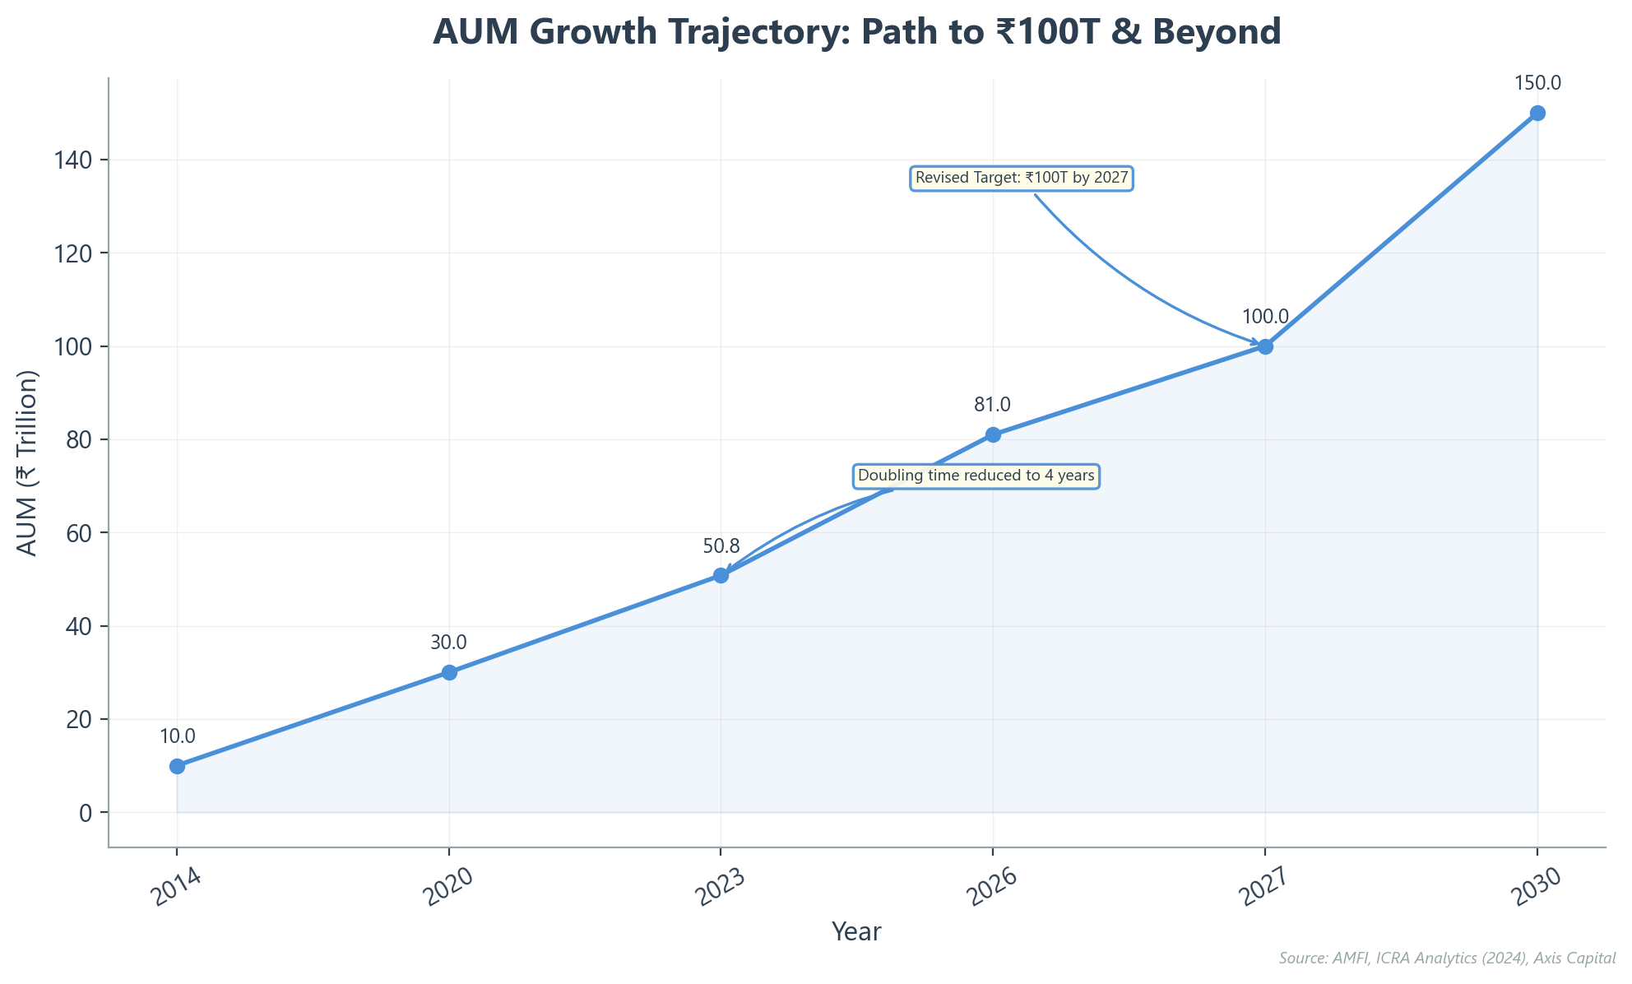
Accelerating Towards the ₹100 Trillion Milestone
▸ Industry projected to hit ₹100 Trillion by 2027, ahead of 2030 estimates.
▸ Growth fueled by target of ₹1 Trillion in monthly SIP inflows by 2030.
▸ Retail and HNI investors now command ~60% of total industry assets.
▸ Trajectory requires sustained 16-18% CAGR and robust database security.
▸ Bull case scenario targets potential ₹150 Trillion AUM by 2030.
★ KEY INSIGHT: The industry is calibrated to breach ₹100 Trillion by 2027, driven by accelerating retail inflows.
Client Databases: The Invisible Engine Behind Scal...
Slide 11 of 12

Slide 12
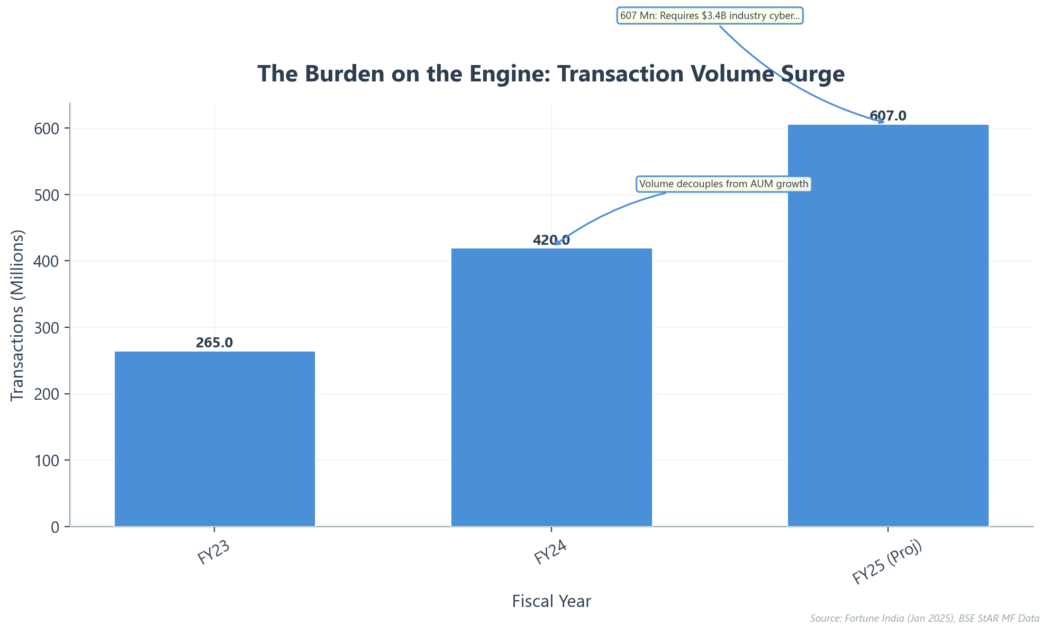
Maintaining the Machine: Scaling Resilience for 2026
▸ Summary: Fuel (SIPs) + Driver (MFDs) + Engine (Data) = Sustainable Scale.
▸ Reality: 90% digital adoption demands zero-downtime infrastructure for 600M+ transactions.
▸ Challenge: Cyber spend rising 17% annually to combat threats to the "Invisible Engine."
▸ Recommendation: Invest in automated reconciliation to handle the next 10 crore investors.
▸ Final Word: Operational resilience is the industry's most visible competitive advantage.
★ KEY INSIGHT: Future success depends on fortifying the digital engine to withstand 600 million+ annual transactions.
Client Databases: The Invisible Engine Behind Scal...
Slide 12 of 12

